Slide 1
Sales Dashboard Design
File created on: 6/14/2025 11:34:25 AM

Slide 2
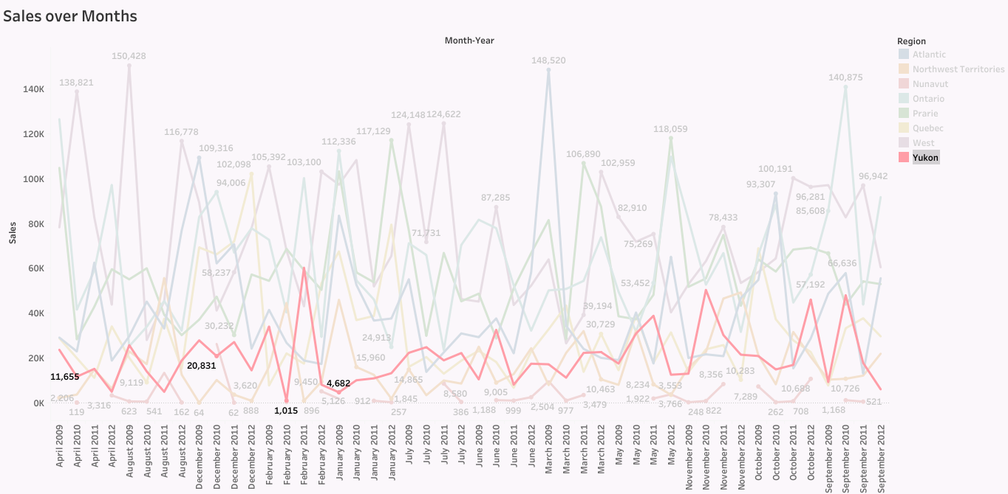

Slide 3
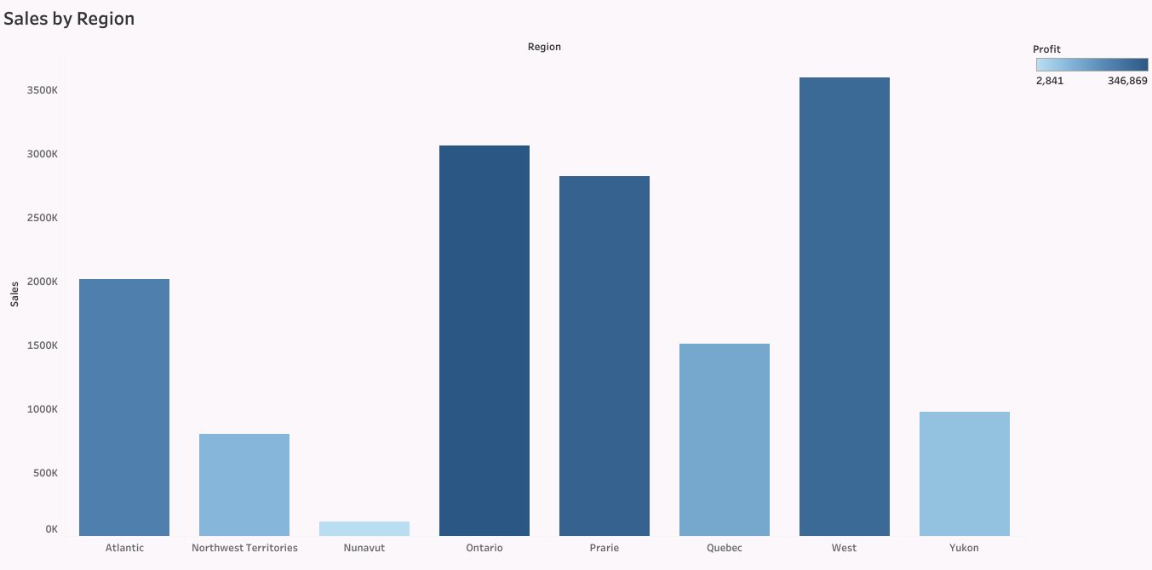

Slide 4
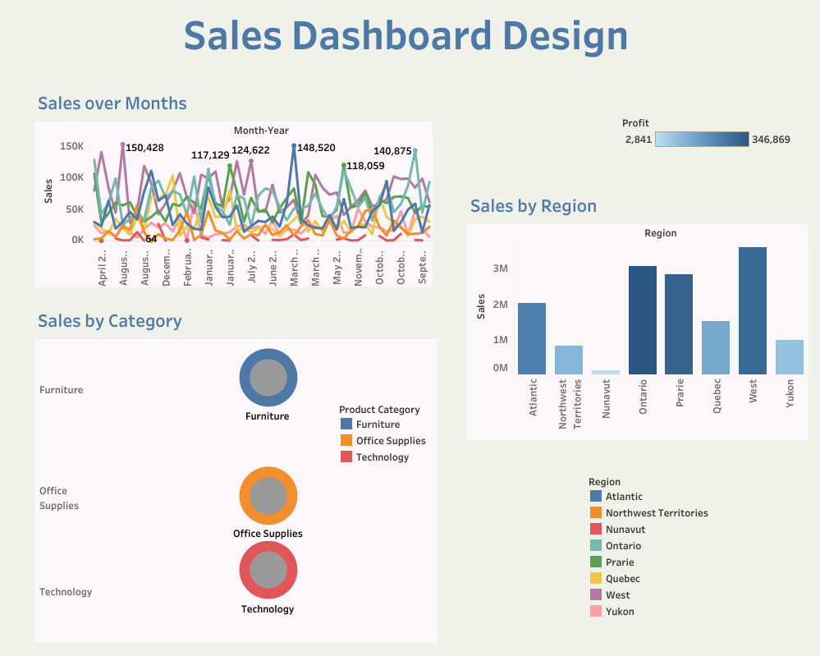

Slide 5
